Slide 1

Detection of AI-Generated Deepfake Images
Project Review - 2
Team Members:
Shiyam Saran S - 122012012830
Rahman N - 122012012822
Sathesh Kumar B - 122012012879
Department: CSE
Project Guide:
Dr.R.Poonguzhali
(Head of the Department, CSE)

Slide 2
INTRODUCTION & PROBLEM BACKGROUND
Introduction:
  Artificial Intelligence, particularly deep learning models like Generative Adversarial Networks (GANs), has enabled the creation of highly realistic synthetic media known as "deepfakes", these are manipulated images.
The Real-World Problem:
    Spreading political misinformation.
    Committing financial fraud and identity theft.
    Eroding public trust in digital media.

Slide 3
PROBLEM STATEMENT
Raise of deepfake images generated using advanced AI techniques.
Increasing difficulty in distinguishing real images from manipulated ones.
Spread misinformation and Misleading Public with fake news.

Slide 4
OBJECTIVES
Study how AI-Generated Images are made and find their weak spots.
Build a smart program that can automatically detect if an image is a AI-Generated or Deepfake.
Test our program on many different kinds of AI-Generated images to see how well it works.
Compare our program with others to prove that it is better.

Slide 5
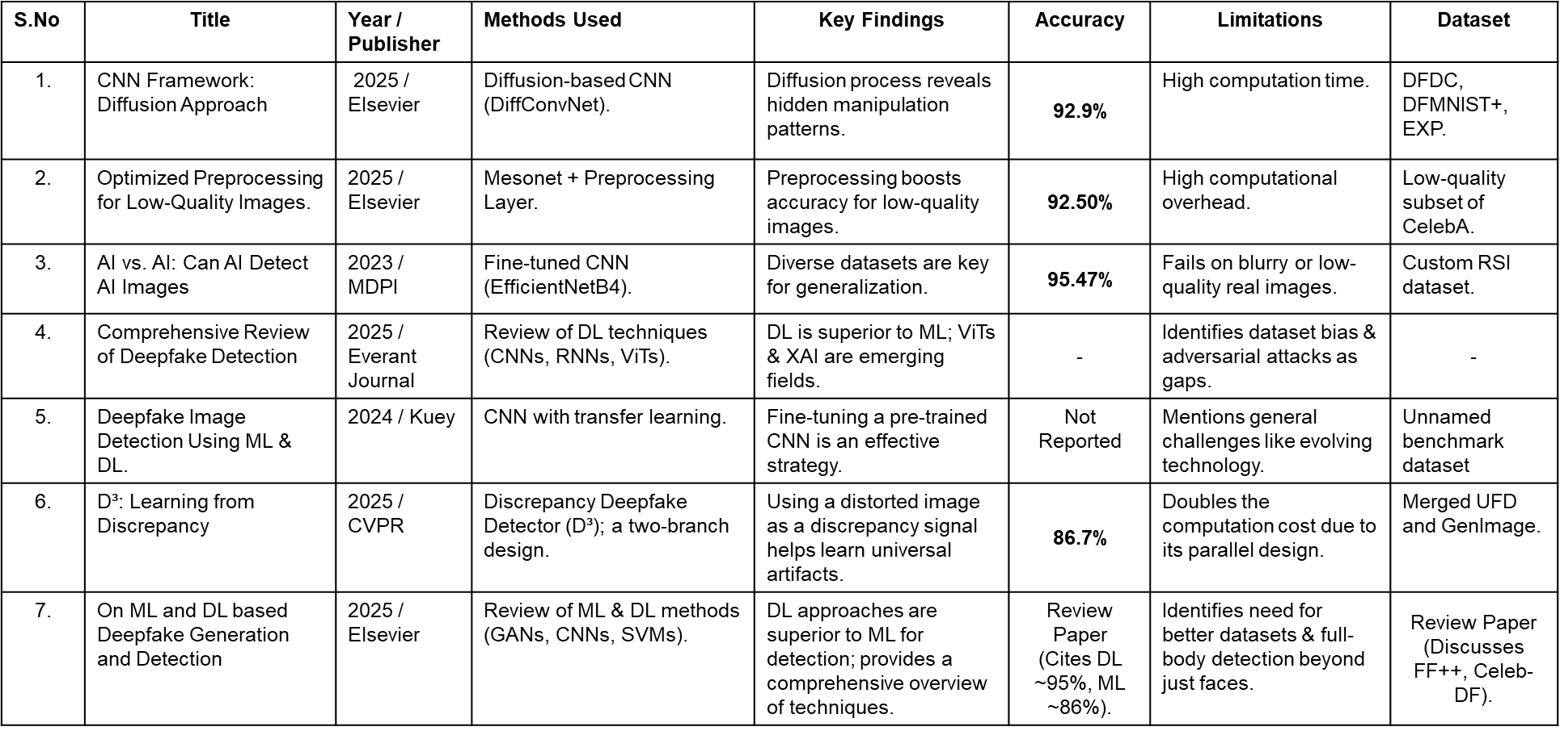
LITERATURE SURVEY

Slide 6
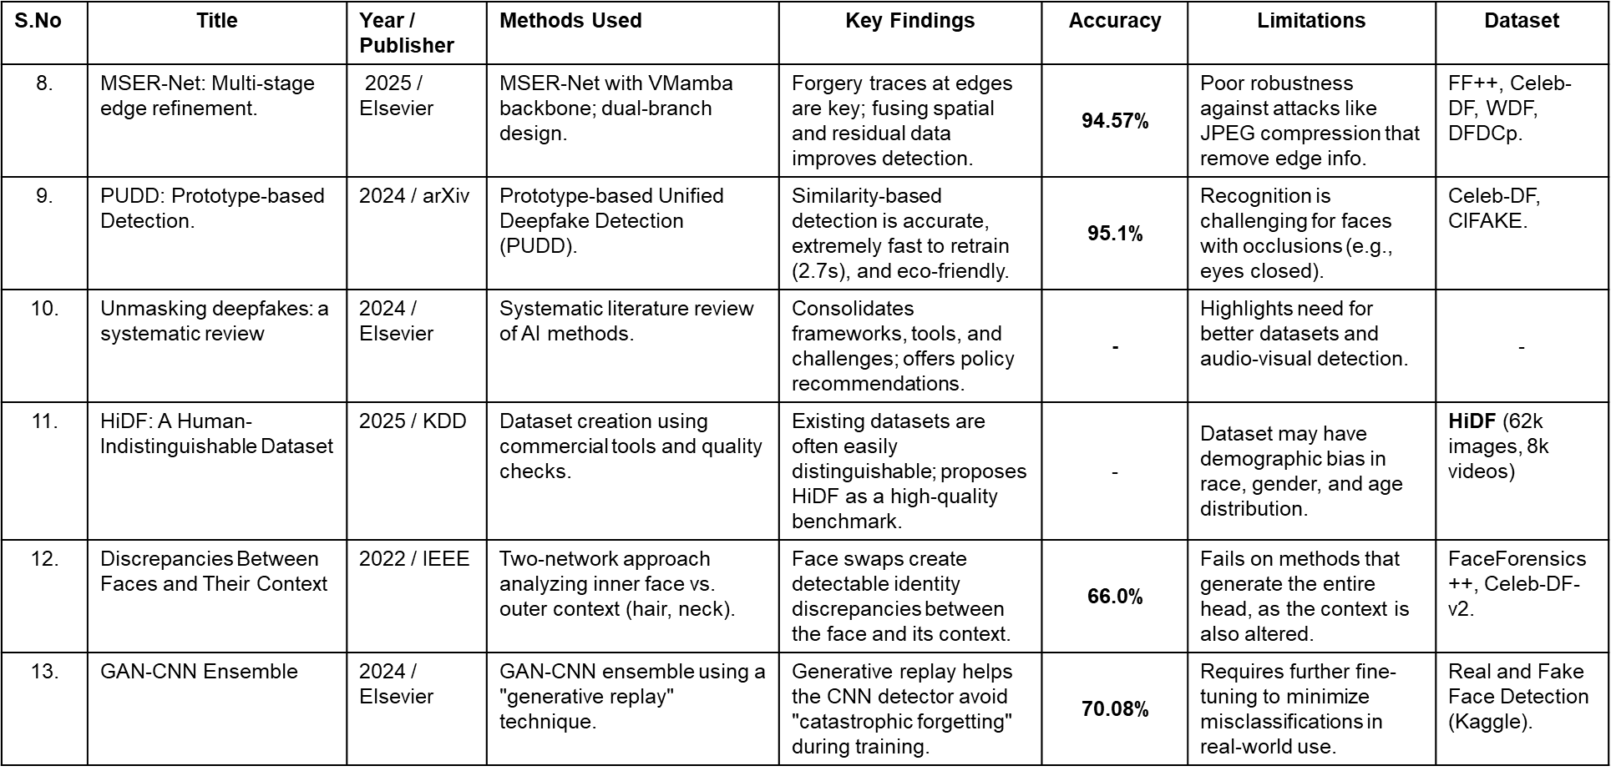
LITERATURE SURVEY

Slide 7
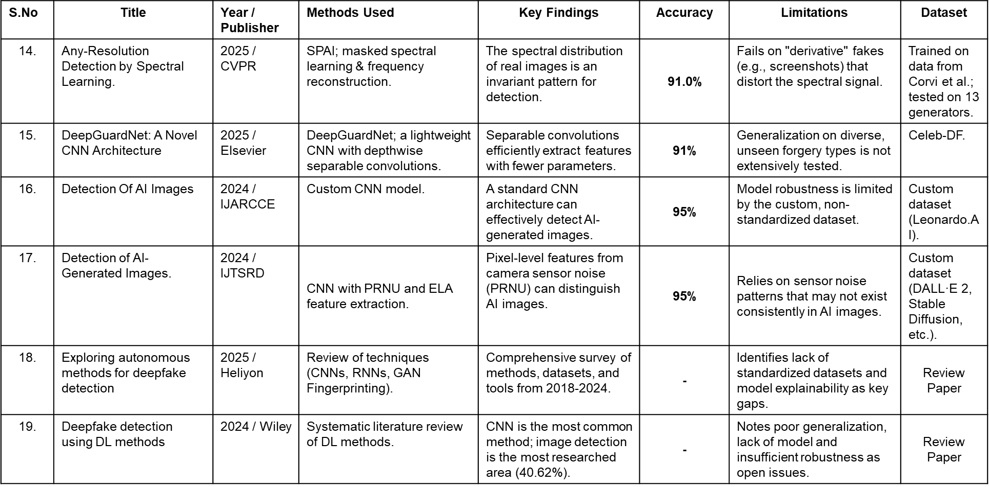
LITERATURE SURVEY

Slide 8
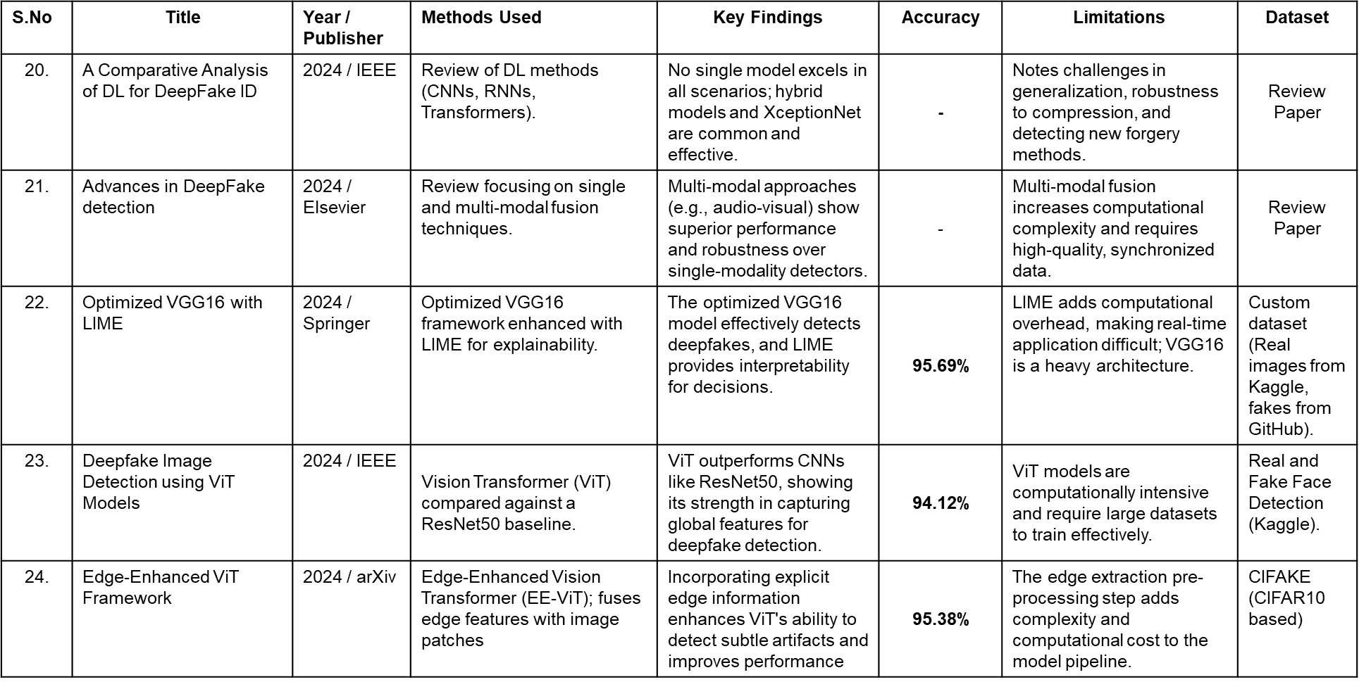
LITERATURE SURVEY

Slide 9
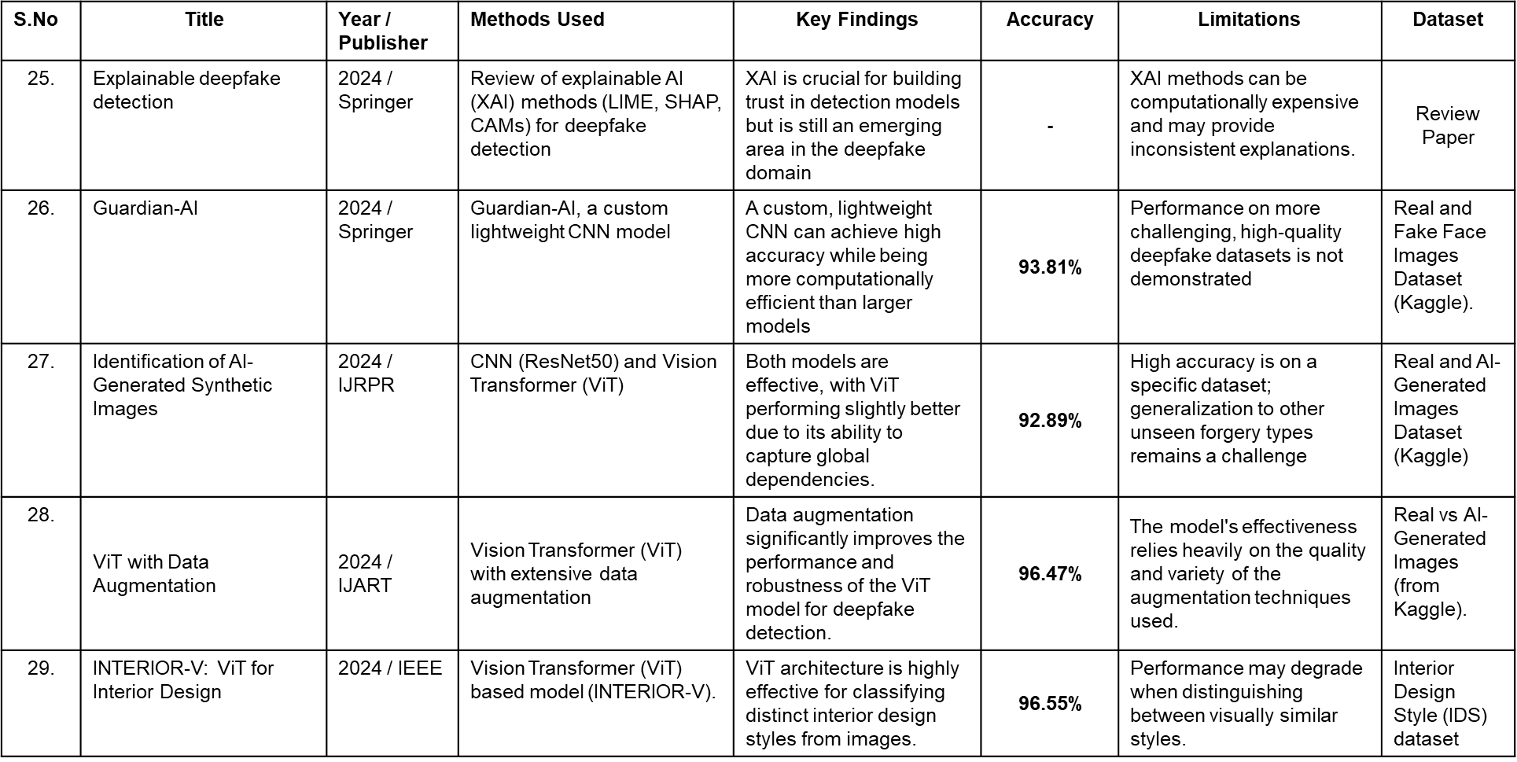
LITERATURE SURVEY

Slide 10
RESEARCH GAP/ MOTIVATION
What's Missing?
  Current detectors look for simple flaws that deepfake creators can easily fix in their next version.
Our Motivation:
  We want to build a detector that finds the deeper, hidden clues that all AI-generated fakes have. This will make our tool harder to fool and useful for a longer time.4

Slide 11
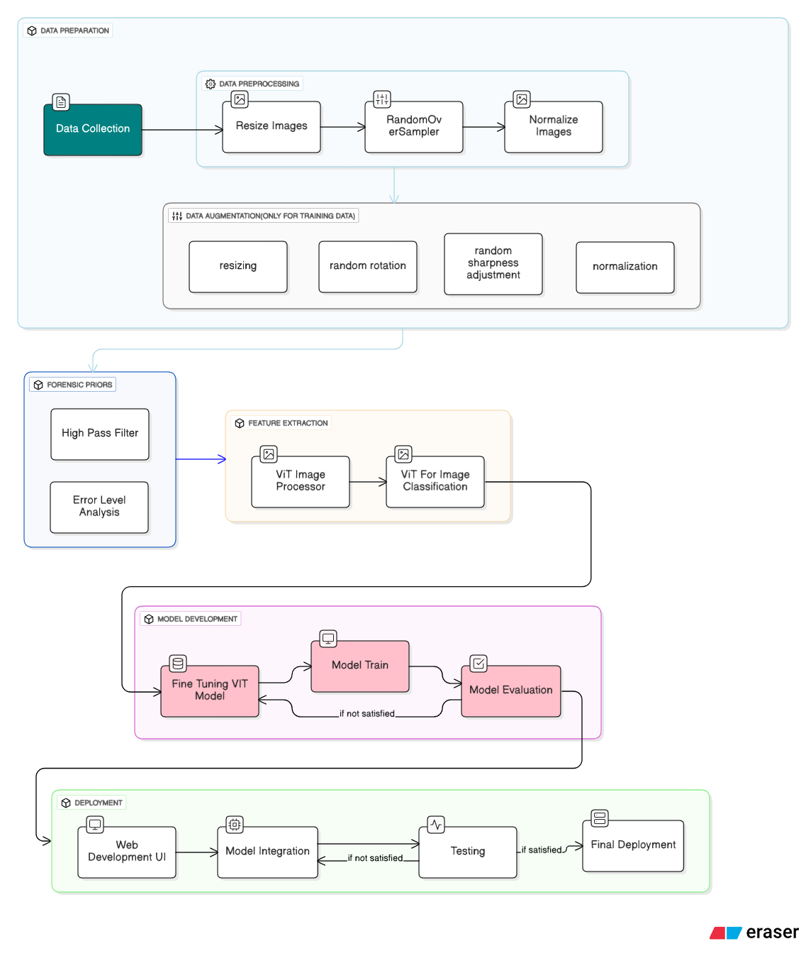
ARCHITECTURE DIAGRAM
OF OUR PROJECT

Slide 12
EXPECTED OUTCOME
Web Application:
    A user-friendly web interface where users can upload an image and instantly receive a classification result (Real or Fake).
Learning Model:
    A robust AI model trained on diverse datasets, ensuring high accuracy and generalization across different deepfake generators.

Slide 13
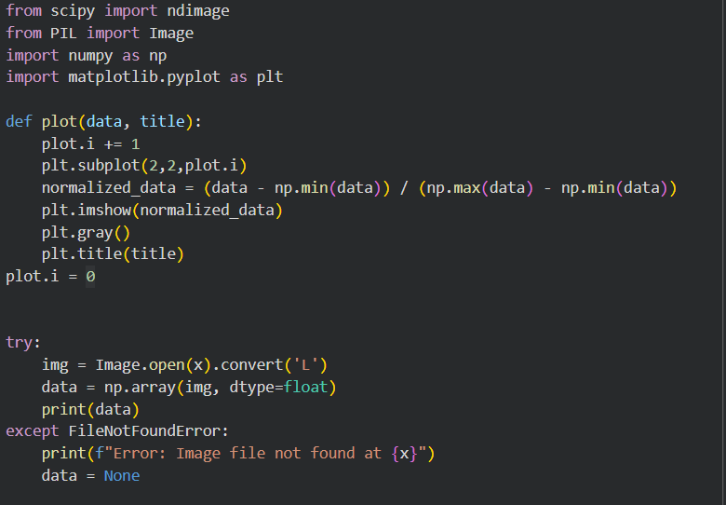
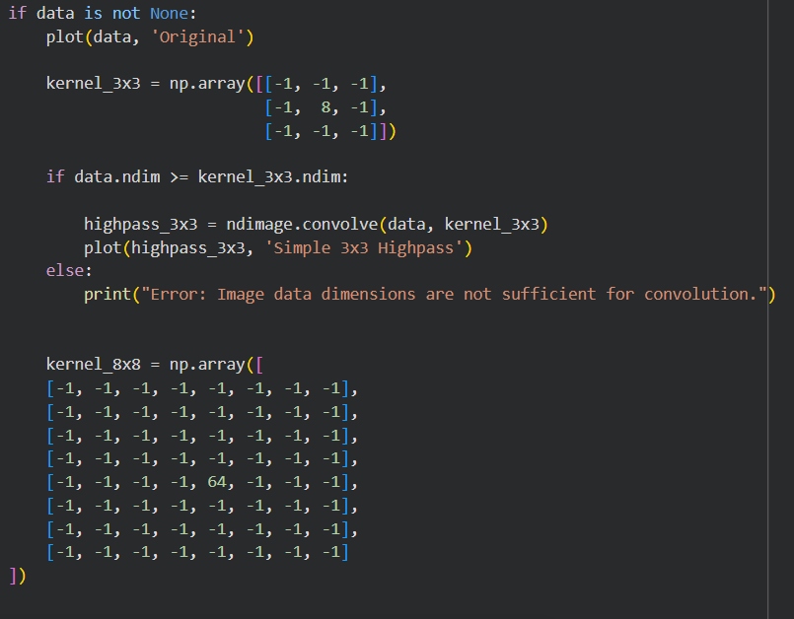
IMPLEMENTATION OF HIGH PASS FILTER MODULE

Slide 14
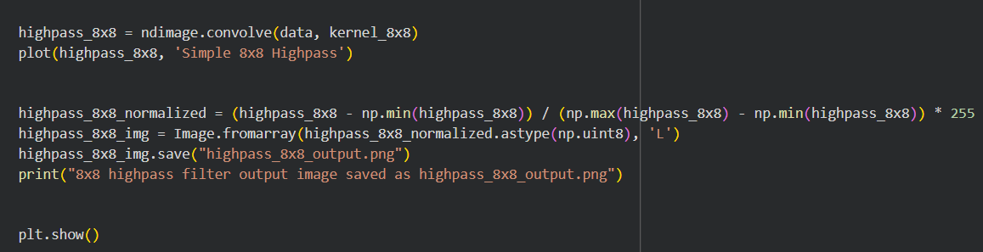
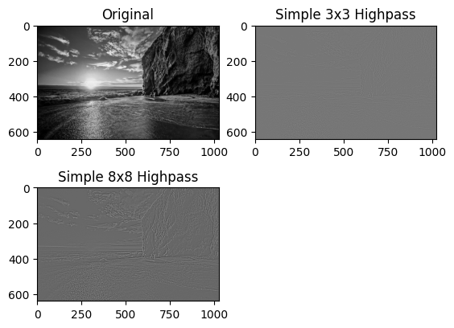
IMPLEMENTATION OF HIGH PASS FILTER MODULE

Slide 15
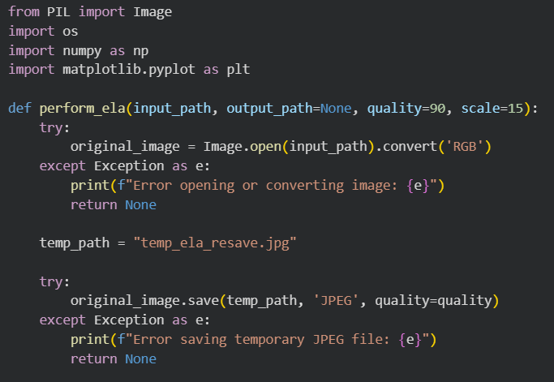
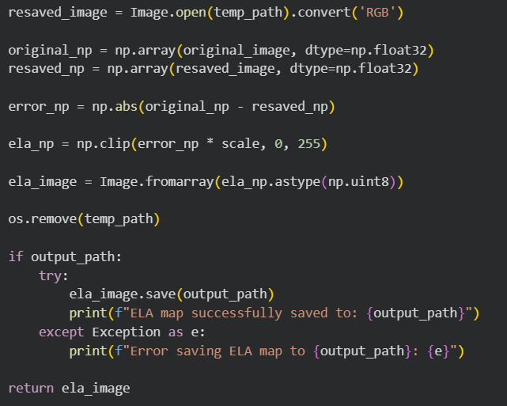
IMPLEMENTATION OF ERROE LEVEL ANALYSIS MODULE

Slide 16
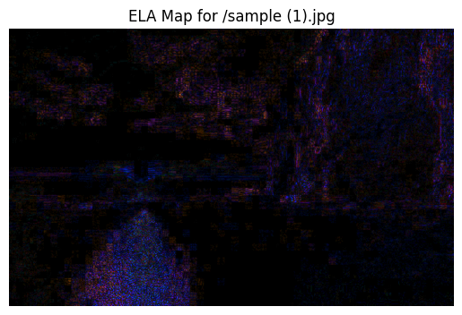

OUTPUT OF ERROR LEVEL ANALYSIS MODULE

Slide 17
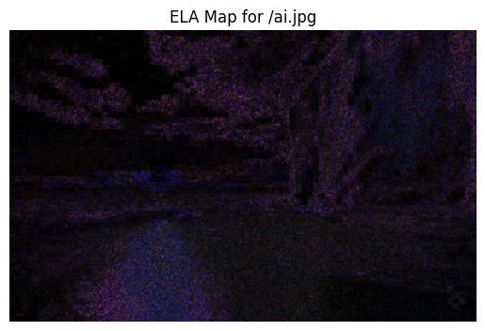

OUTPUT OF ERROR LEVEL ANALYSIS MODULE

Slide 18
CAMPARISIONS OF ELA OUTPUT

Slide 19
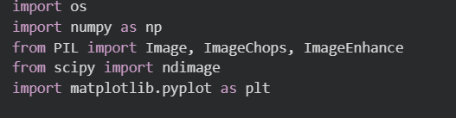
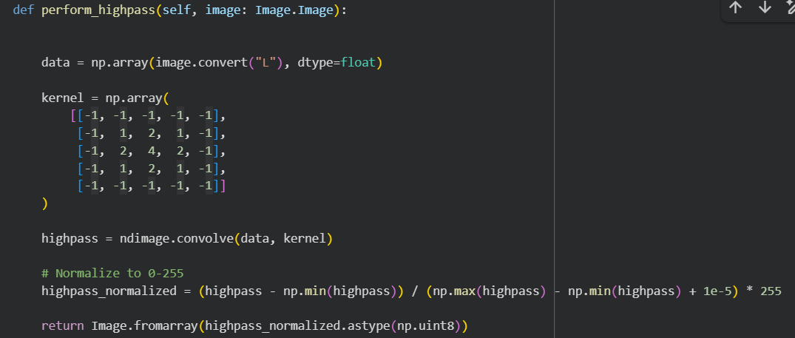
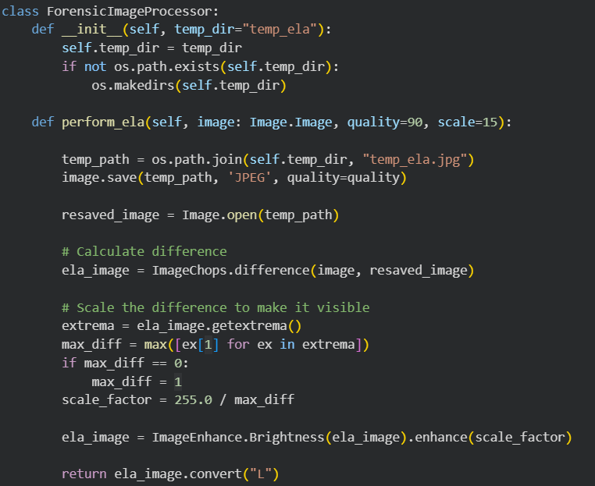
CONVERT THE OP INTO 5 CHANNEL INPUT

Slide 20
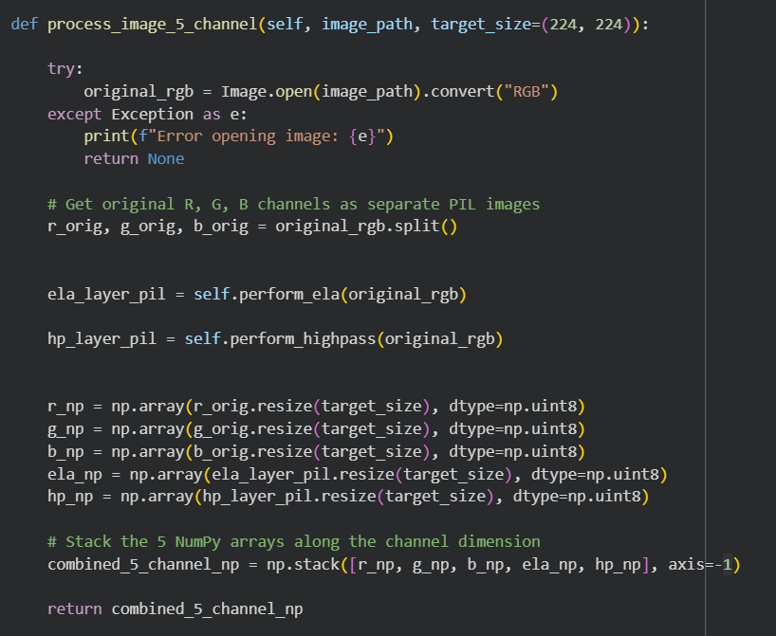
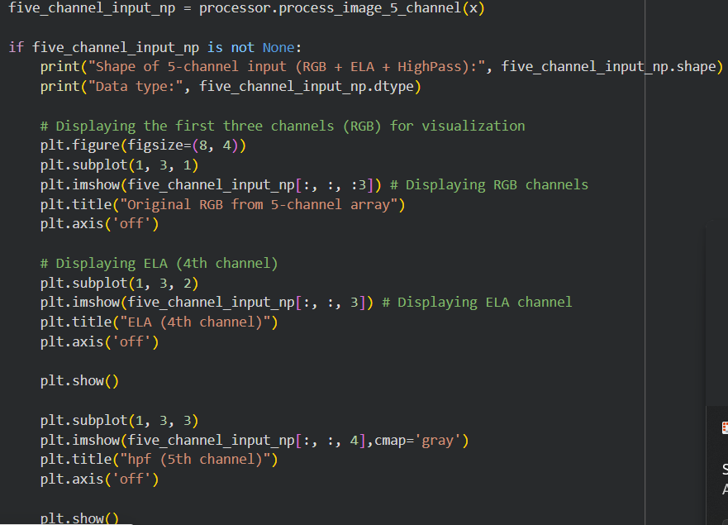
CONVERT THE OP INTO 5 CHANNEL INPUT

Slide 21

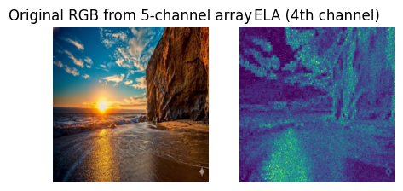
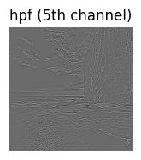
OUTPUT

Slide 22
REFERENCES
Vakdevi Vallabhaneni1,et al."A Comprehensive Review of Deepfake and its Detection Techniques." Engineering and Technology Journal e-ISSN: 2456-3358,2025
Dr. Yatin Patel, et.al "Deepfake Image Detection Using Machine Learning and Deep Learning." EducationalAdministration: Theory and Practice, 2024.
Tian, Y., Fan, L., Isola, P., Chang, H., and Krishnan, D. "Scaling Up Deepfake Detection by Learning from Discrepancy." CVPR, 2023.
Shubham Sharma, et al. "Improved Deepfake Detection with Optimized Preprocessing for low quality images.", Elsevier B.V, 2025.
Alvaro Lopez Pellicer, et al. "Towards Robust Multi-modal Prototype-based Deepfake Detection." arXiv, 2024.
Mohd Tahir Irfan, et al. "On Machine Learning and Deep Learning based Deepfake Generation and Detection." Elsevier B.V,, 2025.
Yupeng Zhang ,et al. "MSER-Net: Multi-stage edge refinement network for deepfake detection” Elsevier B.V, 2025.
Baraheem, et al. "AIvsAI: Can AI Detect AI Generated Images?" Journal od imaging, 2023.
A. Singh, et al. "Convolutional neural network framework for deepfake detection: A diffusion-based approach." Journal of Big Data, 2023.

Slide 23
REFERENCES
S. Kaur, et al. "Unmasking deepfakes: A systematic review of deepfake detection and generation techniques using artificial intelligence." Journal of Network and Computer Applications, 2022.
Akshatha Nayak, et al. "Detection Of AI Generated Images Using Machine Learning and Deep Learning Models." IJARCCE International Journal of Advanced Research in Computer and Communication Engineering, 2024.
Dimitrios Karageorgiou, et al. "Any-Resolution AI-Generated Image Detection by Spectral Learning." arXiv, 2024.
J. Chen, et al. "GAN-CNN Ensemble: A Robust Deepfake Detection Model of Social Media Images Using Minimized Catastrophic Forgetting and Generative Replay Technique." IEEE Transactions on Multimedia, 2023.
Moyang Guo, et al. "Detection of AI-Generated Images." arXiv, 2024.
Reshma Sunil, et al. "Exploring autonomous methods for deepfake detection: A detailed survey on techniques and evaluation." Heliyon, 2025.
A. Shah, et al. "DeepGuardNet: A Novel CNN Architecture for DeepFake Image Detection." ACM International Conference on Multimedia, 2022.
J. Chen, et al. "Deepfake detection using deep learning methods: A systematic and comprehensive review." IEEE Transactions on Multimedia, 2023.
T. Li, et al. "HiDF: A Human-Indistinguishable Deepfake Dataset." CVPR, 2023.

Slide 24
REFERENCES
H. Wang, et al. " Vision Transformer-Based Framework for AI-Generated Image Detection in Interior Design." Informatica 2025.
S. Kaur, et al. "Deepfake Image Detection using Vision Transformer Models." Springer, 2023.
Krity Duhan a, et al. "A Comparative Analysis of Deep Learning Based Approaches for DeepFake Identification." Elsevier B.V ,2025.
Jordan J. Bird, et al. "CIFAKE: IMAGE CLASSIFICATION AND EXPLAINABLE IDENTIFICATION OF AI-GENERATED SYNTHETIC IMAGES." arXiv, 2023.
MD Sarfaraz Momina,d, et al. "Explainable deepfake detection across different modalities: An overview of methods and challenges." Elsevier B.V, 2025.
Dabbrata Das, et al. "Edge-Enhanced Vision Transformer Framework for Accurate AI-Generated Image Detection." arXiv, 2025.
A. Aldrees, et al. "Deepfake detection using optimized VGG16-based framework enhanced with LIME for secure digital content." Elsevier B.V, 2025
A. Aldrees, et al. "Deepfake detection using optimized VGG16-based framework enhanced with LIME for secure digital content." Elsevier B.V, 2025.
Hadeel Alsolai, et al. "GuardianAI: A Comprehensive Approach to Deep Fake Detection in videos using Deep Learning Algorithms." Alexandria Engineering Journal, 2025.
Shrikant Malviya1,et al. "Vision Transformer with Data augmentaion for AI generated image Detection”, De-Factify 4.0, 2025.
Ashish Kumar, et al. "Advances in DeepFake detection algorithms: Exploring fusion techniques in single and multi-modal approach." Information Fusion, 2025.
Zhikan Wang, et al. "A Timely Survey on Vision Transformer for Deepfake Detection." arXiv, 2024
Yuval Nirkin,et al, "DeepFake Detection Based on Discrepancies Between Faces and Their Contex" IEEE Xplore,2023

Slide 25
THANK YOU!

